Slide 1


Trust Towards Information Systems and Meaningful Data Use
WP4 – Building Human Resources Capacity
Regular workshop on research activities, WS 26.1.2026
Dr. Saana Mehtälä
Dr. Kati Clements

Slide 2
WP4 – Building Human Resources Capacity
Objectives
Delivering detailed report or the best practices and standards of EU partners in the field of institutional repositories.
Delivering Summer School
Delivering workshops on IR for inclusive education / copyright issues and plagiarism / regular workshop on research activities
D4.5 Regular workshops on research activities
12 workshops monthly during the last year of the project
“Participation of EU experts / training materials”

Slide 3
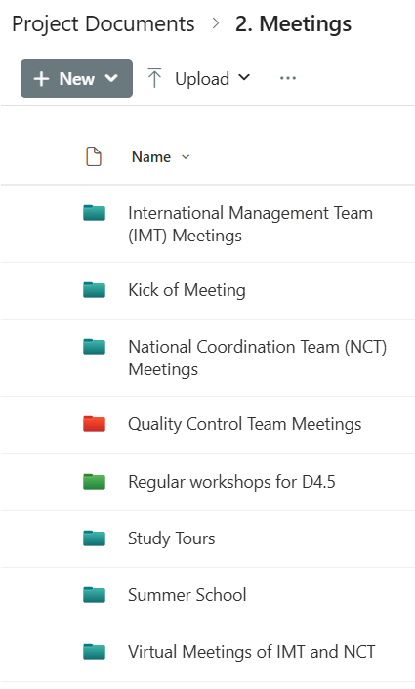
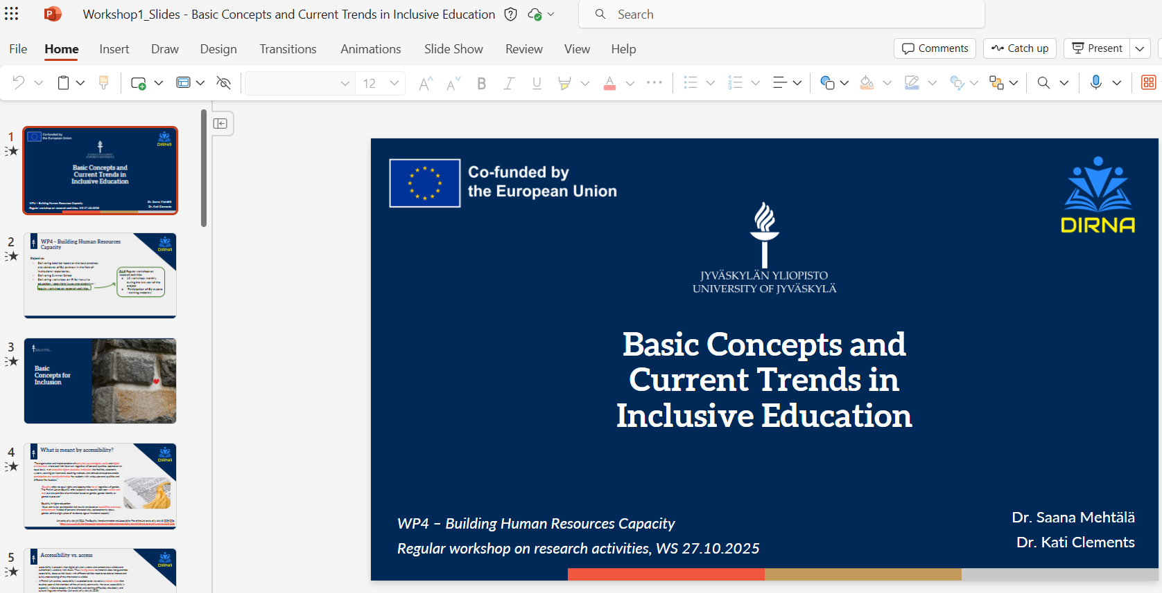
WP4 – Building Human Resources Capacity
Workshops
Workshop 1 – Basic Concepts and Current Trends in Inclusive education (27.10.2025)
Workshop 2 – Metadata, Open Access and Research Visibility in Inclusive Education (24.11.2025)
Workshop 3 – Trust towards Information Systems and Meaningful Data Use

Slide 4

Information Systems

Slide 5
Accessibility in Information Systems
When we talk about digital accessibility, we also need to talk about
System characteristics
User characteristics (and capabilities)
Paradox: we need to be able to discuss accessibility and universal design as phenomena that affect many people and systems, while remaining sensitive towards the very specific needs of individuals
General discussion → further away from needs of real people
Discussion about specific needs → Not generalizable
Understanding phenomena such as digital accessibility requires combining individual, organizational and technical aspects, and not only looking at one or the other
“A challenge when trying to formulate one single definition [of accessibility] is how to do this without falling prey to the metaphysical quest for essence and identity … Any single definition would have to be construed so that both the dynamics of the ever-changing contexts and the ever-changing capacities of the individual are taken into consideration.” (Persson et al., 2015, p.523)
Persson, H., Åhman, H., Yngling, A. A., & Gulliksen, J. (2015). Universal design, inclusive design, accessible design, design for all: different concepts—one goal? On the concept of accessibility—historical, methodological and philosophical aspects. Universal access in the information society, 14(4), 505-526.

Slide 6
Information Systems
Information systems science aims to understand how technology use manifests among individuals and organizations
Continuity (e.g. specific technologies → technology characteristics)
Change (there will always be new technologies, humans, organizations…)
Dynamic relationships between social, physical, digital… environments
Information system does not only refer to technologies, but also the humans included in the processes (often end users, developers)
technology
humans
organizations
time

Slide 7
Technology Use as Technical - Usability
Usability can be defined as how well the functionalities of a system can be used by the intended users
This can include assessing
How easy it is to learn and remember how the system works
How many errors the users make
Whether the use feels efficient or subjectively pleasing
Utility of a system can be evaluated based on how well the intended outcomes are reached
technology
Nielsen, J. (1994). Usability engineering. Morgan Kaufmann.

Slide 8
Technology Use as Individual - User experience
Usability and user experience (UX) are often discussed in parallel (and sometimes confused)
UX aims to view human-computer interaction (HCI) through a more people-oriented lens
preferences, emotions etc.
Objective usefulness ( → instrumental value) vs. subjective experience of use ( → value for humans)
‘System is more than a sum of its parts’
humans
Hassenzahl, M., & Tractinsky, N. (2006). User experience-a research agenda. Behaviour & information technology, 25(2), 91-97.

Slide 9
Technology use as organizational / social – Change resistance vs. acceptance?
Users can actively or passively avoid the adoption of new systems
Change resistance can be viewed as both social and individual phenomenon
Social side more visible in organizational settings
Technical implementation is not enough without authentic user acceptance and adoption to intended tasks
→ Contemporary organizations are complex socio-technical systems
organizations
See e.g.;
Lapointe, L., & Rivard, S. (2005). A multilevel model of resistance to information technology implementation. MIS quarterly, 461-491
Marangunić, N., & Granić, A. (2015). Technology acceptance model: a literature review from 1986 to 2013. Universal access in the information society, 14(1), 81-95.

Slide 10
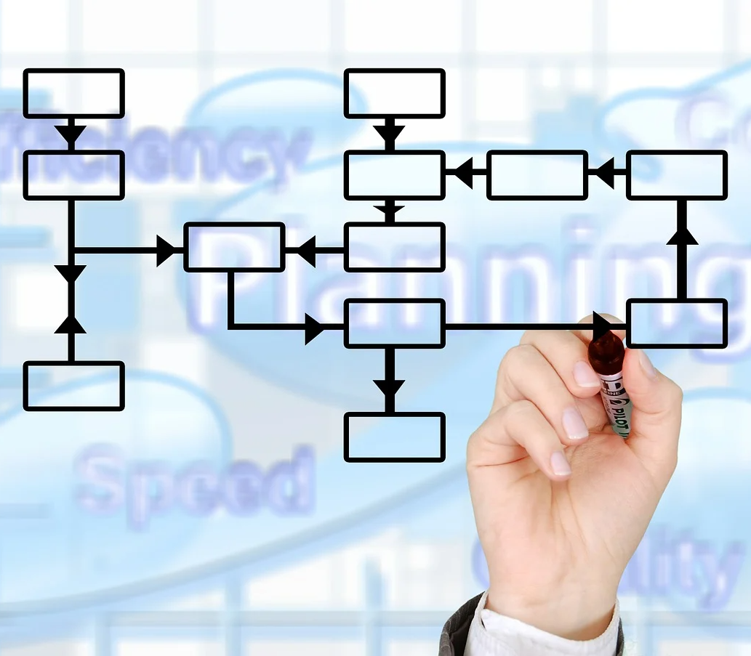
Data in Information Systems

Slide 11
Available data for organizations
Through the use of technology, many organizations have access to a lot of data about their employees
systems automatically log data, devices can be monitored etc.
Data collection methods need to align with the purposes of data use
The more data you collect, the more you need to justify
Purposes of specific systems and how data is collected within them
The role of each system as a part of network of systems (e.g., information can become more identifiable once data across systems is combined)
The more sensitive the information collected, the more solid the justification needs to be
E.g., the concept of personal information can be viewed very broadly (enough if you can recognize yourself in the data)
“Personal data are any information which are related to an identified or identifiable natural person.
The data subjects are identifiable if they can be directly or indirectly identified … Since the definition includes “any information,” one must assume that the term “personal data” should be as broadly interpreted as possible.”
https://gdpr-info.eu/issues/personal-data/

Slide 12
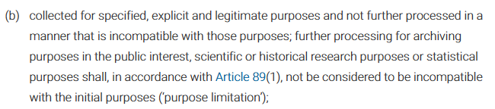
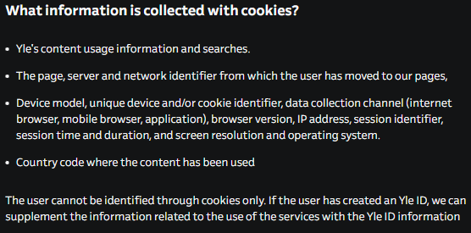
Principles for Data Collection
Only collecting information that is needed / necessary for specific organizational purposes
Understanding users’ rights and clearly explaining users what they are giving their consent to upon using a system
E.g., GDPR vs. traditional cookie policies..
Need to follow ethical principles and synthesize legislative, organizational and system development policies
→ Finding the balance between rights of individuals and organizational objectives
General Data Protection Regulation https://gdpr-info.eu/art-5-gdpr/
The Finnish Broadcasting Company https://yle.fi/aihe/a/20-10000870 (25.1.2026)

Slide 13
Data Practices and Management
“Researchers, research institutions, and organisations…
Data-related quote | Important aspects
…ensure appropriate stewardship, curation, and preservation of all data, metadata, protocols, code, software, and other research materials for a reasonable and clearly stated period” | Appropriate preservation of data over specific time frame
…ensure that access to data is as open as possible, as closed as necessary, and where appropriate in line with the FAIR Principles (Findable, Accessible, Interoperable and Reusable) for data management.” | Appropriate access to data given its characteristics
…acknowledge data, metadata, protocols, code, software, and other research materials as legitimate and citable products of research.” | Trustworthiness of data
…ensure that any contracts or agreements relating to research results include equitable and fair provisions for the management of their use, ownership, and protection under intellectual property rights.” | Openness regarding how to access and lawfully use data
“Researchers inform research participants about how their data will be used, reused, accessed, stored, and deleted, in compliance with GDPR.” | Transparency of data use towards data subjects
(p.7-8)
Allea, 2023. The European Code of Conduct for Research Integrity. https://allea.org/code-of-conduct/

Slide 14
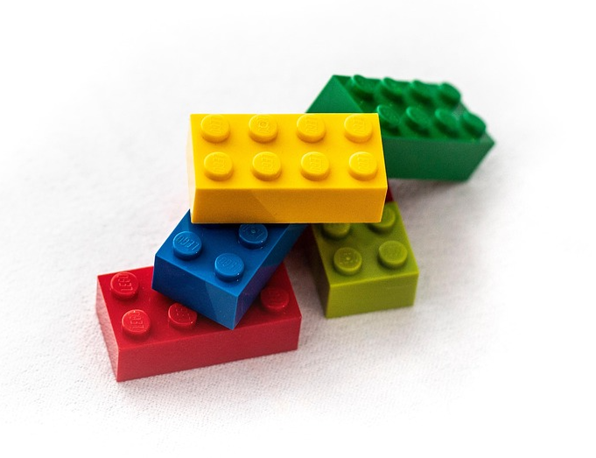
“Useful” data
Available data through the lens of specific organizational objectives
“Data is not useful, only information/knowledge/wisdom is useful”
How data is structured, interpreted and used for organizational purposes
Visibility vs. transparency
Visibility of research outputs
Transparency of processes
Could vs. should
What are the required resources in practice
Actual cost of tech and people vs. achieved outcome

Slide 15

Meaningfulness and Trust

Slide 16

What is meaningful data?
Organizational objectives vs. individuals and the society at large
Useful vs. meaningful (what is the perspective? e.g. usability vs. user experience)
What you actually do based on the data
Different ways to interpret data – interpretations lead to actions that feed future actions etc (regardless whether or not the original interpretation was ‘right’ or ‘wrong’)
To whom is the data useful – recognizing potential (e.g., for innovation)
Does the data somehow enrich societal, organizational, individual outcomes?
Intended impact
Unexpected (positive) impact

Slide 17
Example – Finnish HE students’ health problems and disabilities (EUROSTUDENT 2023)
nearly 1 in 4 students report mental health problems
1 in 8 students report chronic illnesses
ADHD/dyslexia 1 in 14 students
Only half “none of the above”
Mental health problems and ADHD/dyslexia most often viewed as noteworthy challenges to studies
How can we make sure that the tech used at our institution enriches the lives of our students?
Are our accessibility-related policies created with these statistics in mind? How do we view accessibility?
We know that many of our students likely have some challenges with their mental health – if they are not willing to share their specific situations, how can we proactively support them?
Similar challenges rise with GenAI use – how can we make the decisions, if one or more parts of the process are a ‘black box’?
Laamanen, M., Ladonlahti, T., Häkkinen, P. & Kärkkäinen, T (2023). Is student well-being at risk? Higher education students' self-reported health problems and disabilities, digital competency and studying during the covid-19 pandemic. Publications of the Ministry of Education and Culture, Finland 2023:41

Slide 18

Trust as a reciprocal process
Organization ← → Employees
[Teachers ← → Students]
Developers ← → End Users
End User (←) → System
Trust vs. expectation
Our interactions with technologies and other people are based on our previous encounters with them
We expect technologies and people to behave in a certain way
People have often been viewed as the “weak link” of information systems, for example in terms of security (e.g. Sasse et al., 2001)
Users should not intentionally endanger system integrity and admins/systems should not log or have access to more data than they need/claim to log (transparency)
Sasse, M. A., Brostoff, S., & Weirich, D. (2001). Transforming the ‘weakest link’—a human/computer interaction approach to usable and effective security. BT technology journal, 19(3), 122-131.

Slide 19
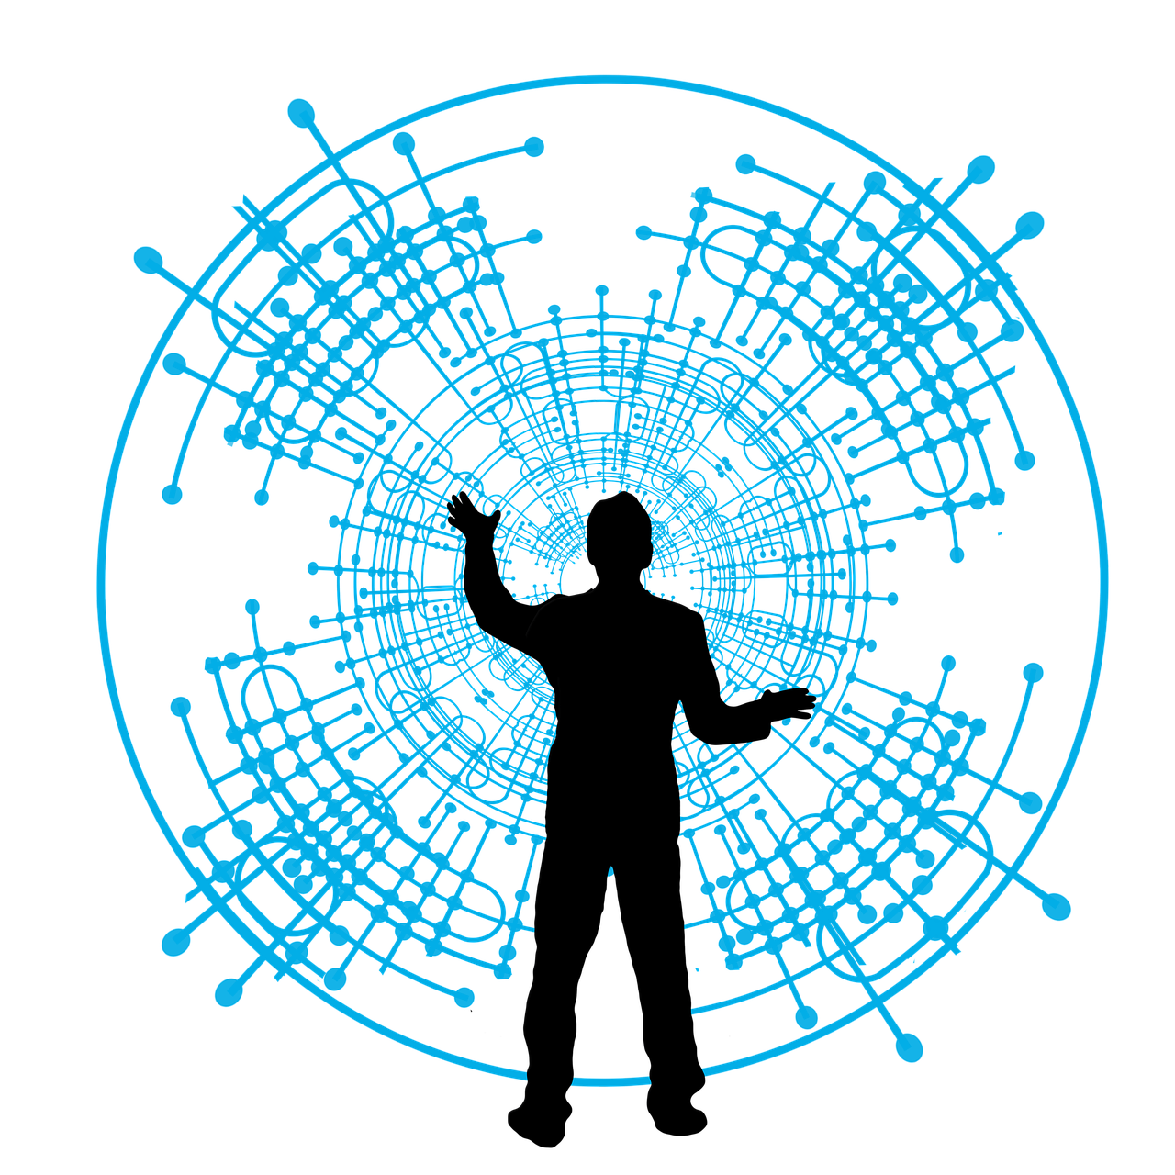
Transparency = trust?
Trust can be viewed a subjective experience that can be promoted through transparency
However, transparent is not the same as ethical
For example, it is important to pay attention on the language used and how accessible the information actually is to the intended target group
Open descriptions of data processing practices do not guarantee that the practices themselves they are justified
Nevertheless, openness gives users the chance to become active agents in their own technology use and evaluate the value of their personal data
For more on technology acceptance, transparency and trust, see e.g., Vorm, E. S., & Combs, D. J. (2022). Integrating transparency, trust, and acceptance: The intelligent systems technology acceptance model (ISTAM). International Journal of Human–Computer Interaction, 38(18-20), 1828-1845.

Slide 20

Towards effective management of meaningful institutional data
Need to understand system-specific data, but also look beyond
Technology use characteristics, snapshots vs. longitudinal data
Viewing users as complex human beings that continuously operate in online/offline and work/leisure environments (see e.g., Lamb & Kling, 2003)
We can never see the full picture, but we can try to steer our actions to benefit our users based on ethics and the information that we have
Acknowledging organizational objectives and how those align with the network of systems
Continuance in systems development practices
Institutional policies aligned with legislation
Lamb, R., & Kling, R. (2003). Reconceptualizing users as social actors in information systems research. MIS quarterly, 197-236.

Slide 21

Thank you! Questions?
saana.s.s.mehtala@jyu.fi
kati.clements@jyu.fi

