Slide 1


Basic Concepts and Current Trends in Inclusive Education
WP4 – Building Human Resources Capacity
Regular workshop on research activities, WS 27.10.2025
Dr. Saana Mehtälä
Dr. Kati Clements

Slide 2
WP4 – Building Human Resources Capacity
Objectives
Delivering detailed report or the best practices and standards of EU partners in the field of institutional repositories.
Delivering Summer School
Delivering workshops on IR for inclusive education / copyright issues and plagiarism / regular workshop on research activities
D4.5 Regular workshops on research activities
12 workshops monthly during the last year of the project
“Participation of EU experts / training materials”

Slide 3

Basic
Concepts for Inclusion

Slide 4

What is meant by accessibility?
“The organisation and implementation of a physical, psychological, social and digital
environment where each individual can, regardless of personal qualities, operate on an equal basis. In an accessible higher education institution, the facilities, electronic systems, learning environments, teaching methods, and attitude atmosphere enable participation and nondiscrimination for students with various personal qualities and different life situations”
“Equality refers to equal rights and opportunities for all regardless of gender. The Finnish Act on Equality refers especially to equality between women and men but also prohibits discrimination based on gender, gender identity or gender expression”
Equality in higher education
“Study admission, participation and results are based on capabilities and study achievements instead of personal characteristics, socioeconomic status, gender, ethnic origin, place of residence, age or functional capacity”
University of Jyväskylä (2024). The Equality, Nondiscrimination and Accessibility Plan of the University of Jyväskylä 2025-2026. https://www.jyu.fi/en/file/the-equality-non-discrimination-and-accessibility-plan-of-the-university-of-jyvaskyla-2025-2026

Slide 5

Accessibility vs. access
Accessibility is present when digital/physical systems and content are available and authentically usable by individuals. Thus, having access to materials does not guarantee accessibility, because individuals with different abilities need to be able to interact and build understanding of the information available
In Finnish Universities, accessibility is expected to be viewed as a shared vision that touches upon all the members of the university community. However, accessibility is especially visible to people with disabilities and learning difficulties, the elderly, and cultural/linguistic minorities (University of Jyväskylä, 2025)
  → Accessibility can be viewed as a multidimensional phenomenon that is more visible to some than others and requires specific consideration depending on the context at hand
      For example – HE lecture materials do not usually need to be accessible for small children (target group: HE students). However, in a research setting studying small children, it is important to make sure that information about the study is provided in a way that is understandable considering the child’s developmental stage
        However – using clear language is a good example of practices that make information more accessible to all people regardless of their abilities
University of Jyväskylä (2025). Saavutettava opiskelu Jyväskylän yliopistossa [Accessible education in the University of Jyväskylä]. https://www.jyu.fi/en/media/19526

Slide 6

Removal of barriers vs. access for all?
In the Finnish language, accessibility can be translated to “esteettömyys” or “saavutettavuus“
  Esteetön means something that is barrier free
    This terms has been used for a long time, and is often used when discussing the accessibility of physical spaces (e.g. for wheelchair users, there is nothing blocking the access)
  Saavutettava is a more literal translation for accessibility, and could also translate to reachable (someone can reach something)
    This term is often used when discussing the accessibility of online environments/materials, such as websites
The conceptualizations surrounding accessibility are important and always tell something about the perspectives from which accessibility issues have been viewed in different cultures over time
  These can also reflect the segments of society on which the issues have been relevant
What are the essential conceptualizations used in your country/culture, and what do they tell about inclusion as a practice?

Slide 7

Promoting Inclusive Education in European HEIs

Slide 8
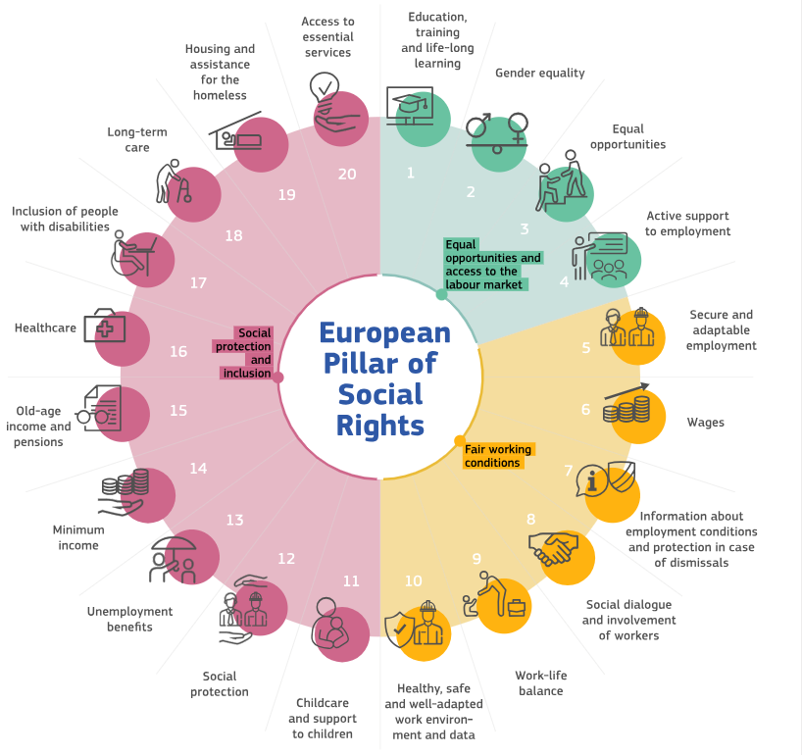
The European Pillar of Social Rights in 20 principles (1/2)
Right to good education and training for everyone
Equal treatment between genders
Same fair chance to take part in the world for all
Taking part in the world when living with a disability
Guiding principles towards fairness, inclusion and the provision of opportunities to promote citizens’ rights in EU countries
Operationalized into actions on EU level
https://employment-social-affairs.ec.europa.eu/policies-and-activities/european-pillar-social-rights-building-fairer-and-more-inclusive-european-union/european-pillar-social-rights-20-principles_en

Slide 9
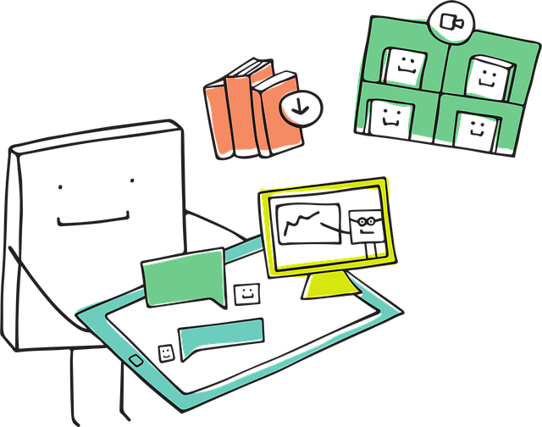
The European Pillar of Social Rights in 20 principles (2/2)
Chapter I: Equal opportunities and access to the labor market
Education, training and life-long learning
“Everyone has the right to quality and inclusive education, training and life-long learning in order to maintain and acquire skills that enable them to participate fully in society and manage successfully transitions in the labour market.”
Gender equality
“Equality of treatment and opportunities between women and men must be ensured and fostered in all areas, including regarding participation in the labour market, terms and conditions of employment and career progression.”
Equal opportunities
“Regardless of gender, racial or ethnic origin, religion or belief, disability, age or sexual orientation, everyone has the right to equal treatment and opportunities regarding employment, social protection, education, and access to goods and services available to the public. Equal opportunities of under-represented groups shall be fostered”
Chapter III: Social protection and inclusion
17. Inclusion of people with disabilities
“People with disabilities have the right to income support that ensures living in dignity, services that enable them to participate in the labour market and in society, and a work environment adapted to their needs”
https://employment-social-affairs.ec.europa.eu/policies-and-activities/european-pillar-social-rights-building-fairer-and-more-inclusive-european-union/european-pillar-social-rights-20-principles_en

Slide 10
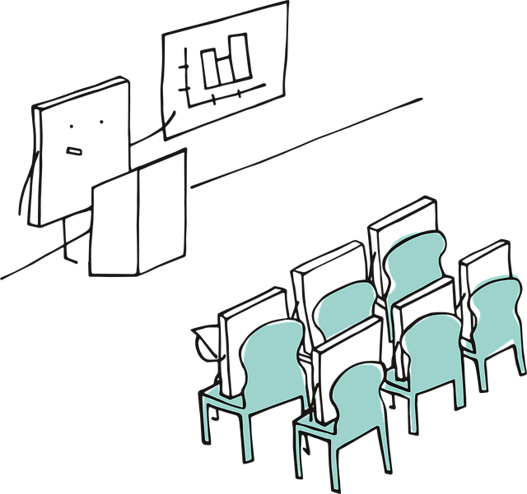
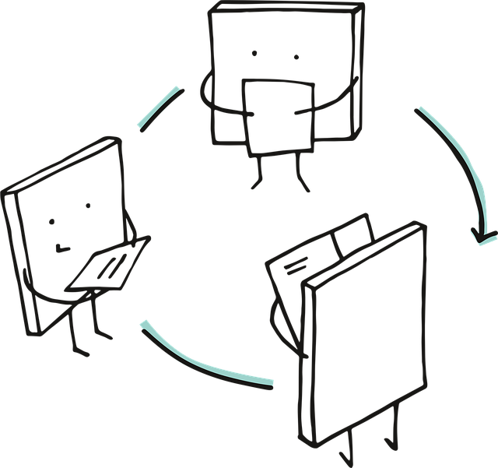


Inclusive practices in higher education
FORTHEM Alliance is a European Universities Network designed to enhance the mobility of students and staff members. It is also boosting cooperation with university-external stakeholders as well as the civic activity of students.
FORTHEM recommendations for diversity-sensitive and inclusive teaching (FORTHEM Alliance, 2024)
University as a diversity-sensitive space
Anti-discriminatory curricula
Accessible teaching material
Inclusive language
Diversity-sensitive lecture planning
Diversity-sensitive planning of non-teaching events
Diversity-sensitive planning of field trips
Diversity-sensitive interactions in the classroom
Diversity-sensitive advising
Accessible social media content
“Diversity-sensitive and inclusive teaching … is intended to reduce barriers and to guarantee the participation of every student to the greatest possible extent – regardless of their different backgrounds, identities, abilities, and life experiences. This type of approach contributes to a learning environment that is equitable, respectful, and accessible, with the goal of enabling all students to reach their full potential”
FORTHEM Alliance, 2024. Joint recommendations on diversity-sensitive and inclusive teaching. https://www.jyu.fi/en/file/joint-recommendations-on-diversity-sensitive-and-inclusive-teaching

Slide 11

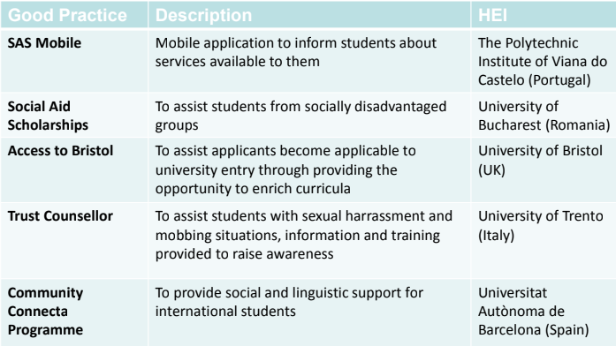
The Access4All project
The Access4All Erasmus+ project (-2018) aimed to collect and build understanding of inclusion practices among european HEIs (Finnish, Spanish, British, Italian, Portugal and Romanian)
Why do we need practices for inclusion?
Traditionally, standardized models and definitions for good practices have been scarce (E.g. Wellstein & Kieser, 2011) → need for unified ways to collect, store and evaluate practices in different fields
There has been increased research interest in providing universal access to HE among individuals (e.g., Jerónimo et al., 2017) → HEIs need to be capable of meeting the diverse needs of students
https://www.jyu.fi/en/projects/access4all
Jerónimo, M., Duarte, A., Frade Mangas, C., Sousa, C., Seco, G., Sousa, P., Matos dos Santos, T. (2017) Promoting good practices for equity and inclusion in portuguese Higher Education: a comprehensive approach at the national and institutional level.
Wellstein, B. & Kieser, A. (2011). Trading “best practices” – a good practice? Industrial and Corporate Change, 20(3), 683-719.

Slide 12
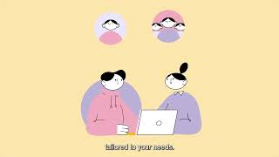
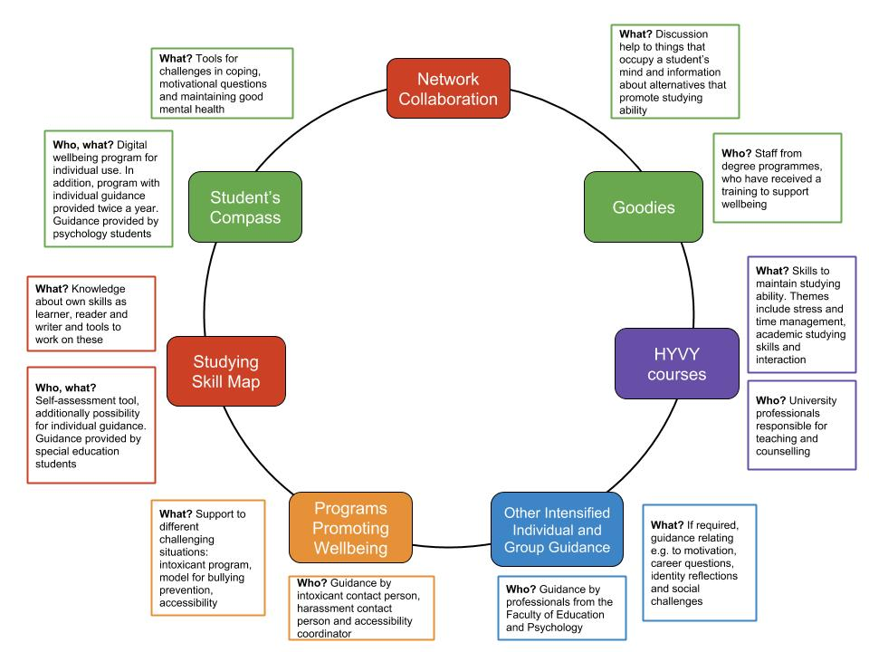
Practices for inclusion at JYU 1/3
Student’s Compass (https://ok.jyu.fi/en)
Wellbeing and life skills program, aimed at solving issues (e.g., due to stress) and promoting the overall wellbeing of students
Practical tools and exercises (e.g. mindfulness), research-based
The Goodie model
Faculties include staff that are trained to better support the wellbeing of students
Private discussions with Goodies can center around many different topics (e.g., balancing study and leisure time, lack of motivation, loneliness)
https://www.jyu.fi/en/for-students/instructions-for-bachelors-and-masters-students/student-wellbeing/goodies-student-wellbeing-advisers

Slide 13
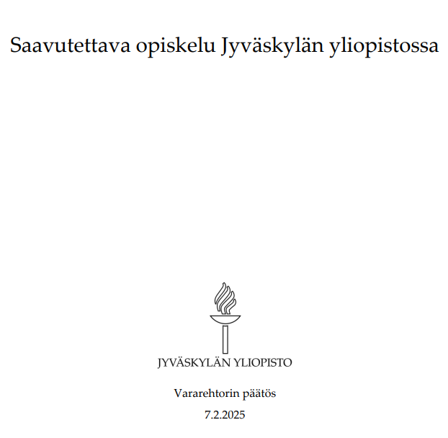
Practices for inclusion at JYU 2/3
Vice Rector’s Decision on Accessible Education
In JYU, the guiding principles for equality, non-discrimination and accessibility are regularly updated
The vice rector’s decision on accessible education outlines university’s activities and roles in relation to accessibility
Responsibilities of the university include..
  providing every student the possibility to use the university’s physical and ICT environments
  making sure that enough information is provided to staff and students to ensure accessibility
Responsibilities of the faculties and departments include..
  making sure that entrance examinations are equal
  providing communication and learning materials that are accessible
  creating individual arrangements for students in collaboration with university services when needed
Responsibilities of the students (or applicants) include..
  informing the university about possible barriers and apply for individual arrangements
University of Jyväskylä (2025). Saavutettava opiskelu Jyväskylän yliopistossa [Accessible education in the University of Jyväskylä]. https://www.jyu.fi/en/media/19526

Slide 14
Practices for inclusion at JYU 3/3
Individual arrangements
Adapting exams/courses to better suit the needs of individuals
  e.g., more time to finish an exam, extra lightning, more peaceful space
  alternative ways to complete a course, flexibility in course demands
Individual arrangements are comparative to the reasonable adjustments that are outlined in the Finnish Non-Discrimination Act
  thus, not complying with the individual arrangements can be viewed as a violation of the law
→ institutional guidelines for inclusion need to be transparent and easily understandable to the staff and students (rights, obligations)
“adapting course completion practices to fit a certain situation is about increasing equality, not about making the course easier. The goal of individual arrangements is to provide all students equal possibilities to show their
competence in the subject they are studying”
-student counsellor @ JYU
https://www.linkedin.com/pulse/through-eyes-student-counselor-accessibility-equality-saana-meht%C3%A4l%C3%A4/
https://www.linkedin.com/pulse/accessibility-coordinators-thoughts-inclusion-equality-saana-meht%C3%A4l%C3%A4/
https://www.jyu.fi/en/for-students/instructions-for-bachelors-and-masters-students/study-planning-and-counselling/accessibility-and-individual-services

Slide 15
Barriers and facilitators of inclusion in HE
The Access4All project showed that both physical and online environments can still be inaccessible to students
  Old university buildings can be physically hard to reach and not all spaces are ergonomic (e.g. certain seats can be problematic to students experiencing chronic pain)
Accessibility practices might not be actively brought to the attention of students
Inclusion can be promoted e.g. through good quality student counselling, providing comprehensively available online course materials and having spaces that support different learning styles
“physical, social and ICT environments should primarily be designed to fit everyone’s needs. Therefore, individual arrangements in their current form are merely repairing actions, since they are used to supplement solutions that are not inclusive to start with.”
-accessibility coordinator @ JYU
→ EU wide directives etc. can be important for promoting inclusion, but the priority should be on making people’s lives easier right now (fostering human participation vs. complying with [whatever] regulations)
https://www.linkedin.com/pulse/accessibility-coordinators-thoughts-inclusion-equality-saana-meht%C3%A4l%C3%A4/
https://www.linkedin.com/pulse/how-increase-accessibility-equality-higher-education-student-meht%C3%A4l%C3%A4/

Slide 16

Future of Inclusive Education?

Slide 17

Inclusion and AI design/use
Past research on diversity in the era of AI have mostly focused on observing gender and race as attributes
  The visibility of age, disability and ethnicity have also been explored to some degree
There is lack of research focusing on AI-related diversity and inclusion within the field of education
In general, there seems to be a lack of awareness of the diversity and inclusion issues, and these principles are often not implemented to AI systems
Shams, R. A., Zowghi, D., & Bano, M. (2025). AI and the quest for diversity and inclusion: a systematic literature review. AI and Ethics, 5(1), 411-438.
→ Need to 1) systematically include people with diverse backgrounds and abilities to the co-development of AI technologies and to 2) systematically explore the potential of different AI technologies in promoting accessibility for all

Slide 18


Continuity vs. innovation in inclusion practices
As established, it is important for inclusive educational practices to be connected with regional, national and local policies to ensure compliance and the realization of individual’s rights
  continuity between legislation, policies and practices
  this can also make institutional inclusion practices less agile, making it less straightforward to be able to respond to new developments in a timely manner (e.g., tech, research)
Emerging technologies (e.g. AI) can create both barriers and solutions to accessibility and inclusion
→ Need to find a balance between stability and the opportunities/challenges that are present in the current socio-technological environment

Slide 19
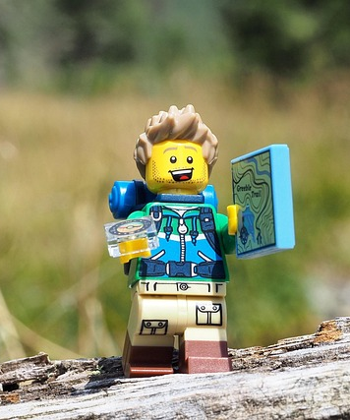
Aspects to think about regarding your institution’s policies / your own practices
What do I know about my institution’s policies towards inclusion?
How are the institutional policies visible on a practical level?
What makes my teaching/training and related materials accessible and inclusive (e.g., in terms of content, systems used, or the atmosphere created)?
Are there any specific areas that I should pay more attention towards?
How could I make my work more inclusive in the future?

Slide 20
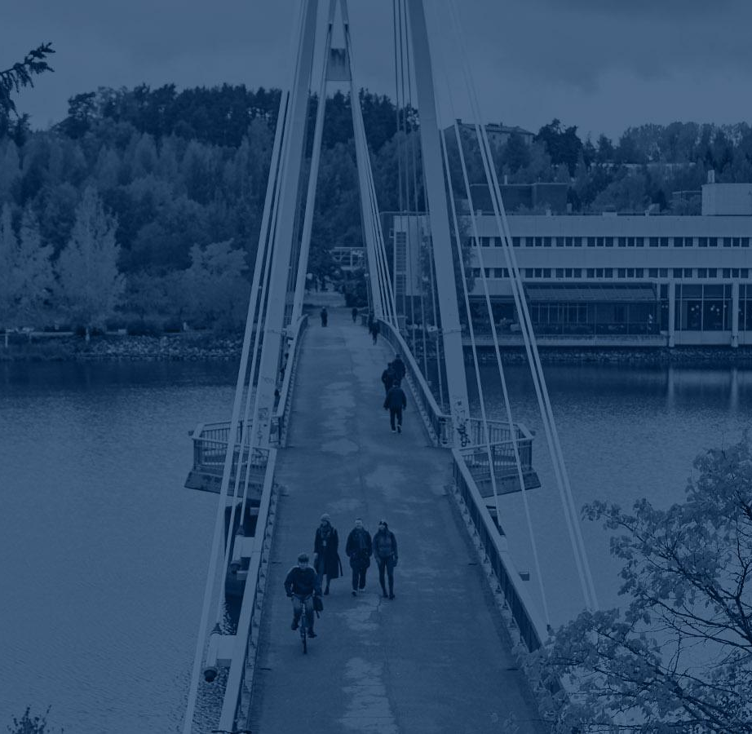
Thank you!
Questions?
saana.s.s.mehtala@jyu.fi
kati.clements@jyu.fi

