Slide 1


Metadata, Open Access, and Research Visibility in Inclusive Education
WP4 – Building Human Resources Capacity
Regular workshop on research activities, WS 24.11.2025
Dr. Saana Mehtälä
Dr. Kati Clements

Slide 2
WP4 – Building Human Resources Capacity
Objectives
Delivering detailed report or the best practices and standards of EU partners in the field of institutional repositories.
Delivering Summer School
Delivering workshops on IR for inclusive education / copyright issues and plagiarism / regular workshop on research activities
D4.5 Regular workshops on research activities
12 workshops monthly during the last year of the project
“Participation of EU experts / training materials”

Slide 3
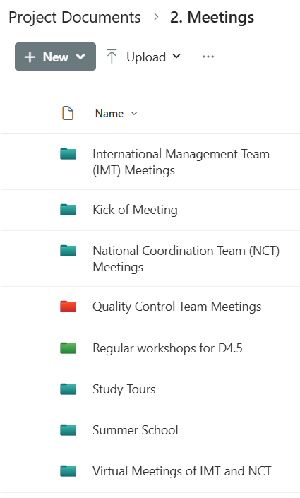
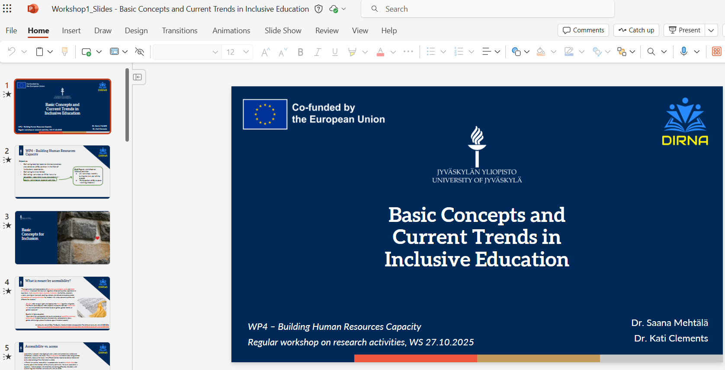
WP4 – Building Human Resources Capacity
Workshops
Workshop 1 – Basic Concepts and Current Trends in Inclusive education (27.10.2025)
Workshop 2 – Metadata, Open Access and Research Visibility in Inclusive Education (24.11.2025)

Slide 4

Basic Concepts of Digital Accessibility

Slide 5

What is meant by digital accessibility?
Accessibility
“The organisation and implementation of a physical, psychological, social and digital
environment where each individual can, regardless of personal qualities, operate on an equal basis. In an accessible higher education institution, the facilities, electronic systems, learning environments, teaching methods, and attitude atmosphere enable participation and nondiscrimination for students with various personal qualities and different life situations”
Equality in higher education
“Study admission, participation and results are based on capabilities and study achievements instead of personal characteristics, socioeconomic status, gender, ethnic origin, place of residence, age or functional capacity”
Digital systems
and system characteristics
Characteristics of individual users
University of Jyväskylä (2024). The Equality, Nondiscrimination and Accessibility Plan of the University of Jyväskylä 2025-2026. https://www.jyu.fi/en/file/the-equality-non-discrimination-and-accessibility-plan-of-the-university-of-jyvaskyla-2025-2026
→ Digital (or online) accessibility refers to the accessibility of digital environments
(e.g., software, hardware and online material)
→ Educational practices cross online and offline environments – environments can differ in
how they support the agency of students and teachers

Slide 6
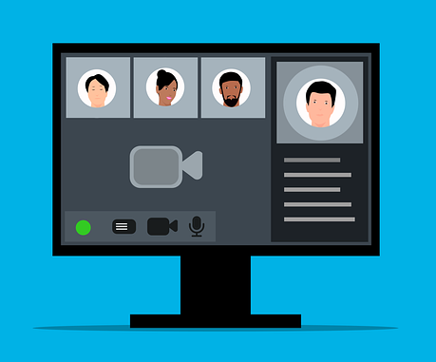
Design for Accessibility and Accessible Systems
The Accessibility of Education at the University of Jyväskylä decision states that the university needs to follow the Design for All principle
The planning of new solutions and purchases (e.g. information systems, devices and learning materials) needs to be done using means that promote the usability and accessibility for all users
Thus, accessibility needs to be factored in regardless of whether new solutions are developed or existing software/hardware is taken into use
→ In authentically accessible systems, the relevant dimensions
of accessibility would be actively considered from initial
solution development to daily use (e.g., meaningful use of
content and system features)
“Design for All ensures that all people have equal access to everything offered by the society, while fostering respect for diversity and promoting the quality of life for all through empathy in the design of spaces, products and services.”
https://designforall.org/
https://www.jyu.fi/fi/file/saavutettava-opiskelu-jyvasktlan-yliopistossa-paatos
https://www.jyu.fi/en/about-us/organisation-and-management/regulations-and-principles/equality-and-diversity

Slide 7

Accessible Data
Accessibility can be viewed as a guiding principle for both the design and the use of information systems
In regards to open research data, JYU (like many institutions) follows the principle “as open as possible, as closed as necessary”
Opening can have different degrees, and it can mean providing
Fully openly available data
Restrictedly available data
Descriptive data (metadata)
→ Not everything should (or can) be openly available,
but it is important to identify all instances where
transparency and availability can be increased
“Opening must always be in line with FAIR principles: the researcher hands over the data to an appropriate, trusted body such as a university or archive, which labels it with descriptive information and gives it a permanent identifier (most prominently, DOI). The body thereafter ensures that the data is reliably accessible by means of the identification link and the permanent landing page. The service is also responsible for the distribution and long-term preservation of the data.”
https://www.jyu.fi/en/research/research-data-management/guide/opening-research-data

Slide 8
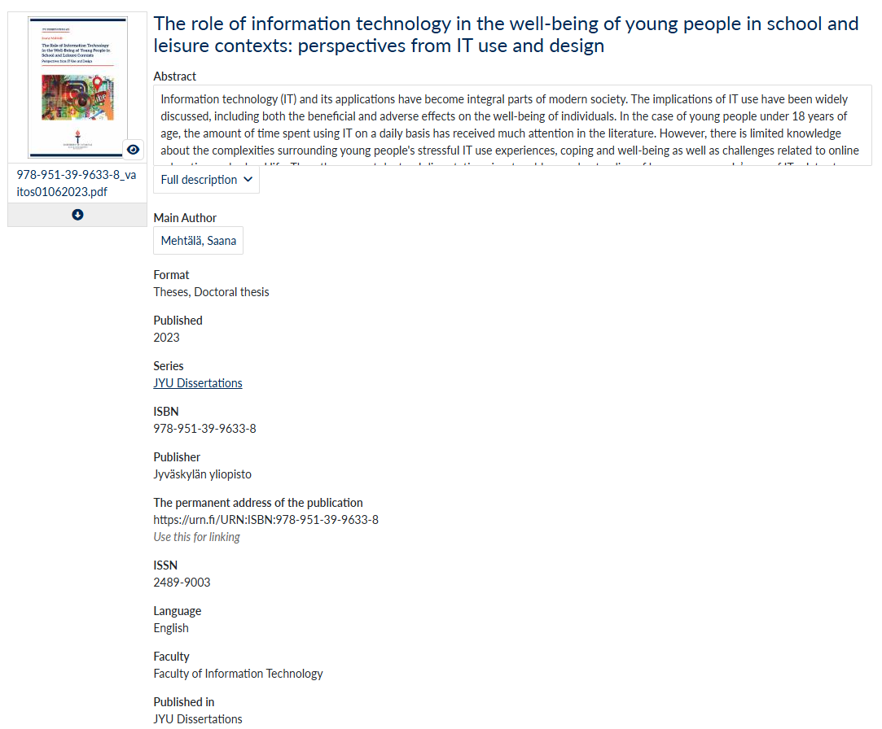
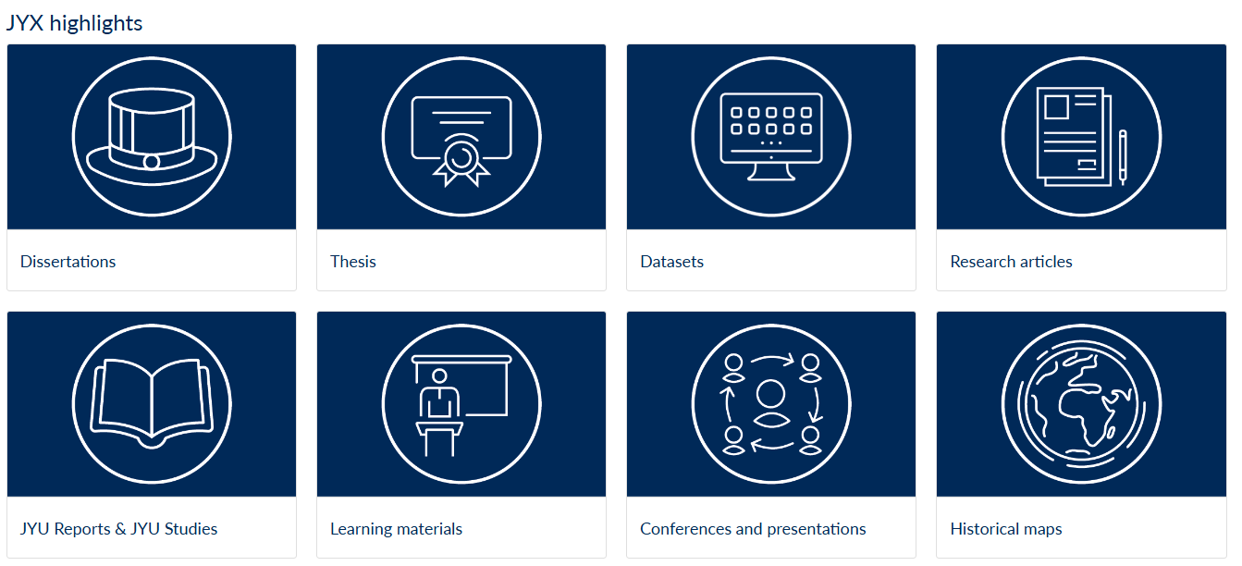
JYX (meta)data
“Unless otherwise stated, publicly available JYX metadata (excluding summaries) may be freely reused with CC0 license”
https://jyx.jyu.fi/jyx/
https://www.jyu.fi/en/data-privacy/the-jyx-repository-of-the-university-of-jyvaskyla-privacy-notice

Slide 9

Meaningfulness of System Characteristics in Accessible Design

Slide 10

Accessibility as a set of design principles 1/2
In Finland, Traficom is the authority that enforces compliance with web accessibility
The aim is to “improve everyone’s possibilities to use digital services on an equal basis”
The Act on the Provision of Digital Services outlines accessibility requirements and obligations that need to be met by public sector organizations
Based on EU’s accessibility directive and the UN Convention on the Rights of Persons with Disabilities
In short,
Digital services and contents must meet relevant technical accessibility requirements (outlined in European standard EN 301 549 and WCAG [Web Content Accessibility Guidelines])
State of accessibility and shortcomings must be evaluated and presented in the accessibility statement (see e.g. JYU website)
Electronic feedback channel must be included and a response to the user’s feedback needs to be provided within 14 days
There are some service-specific requirements
https://www.saavutettavuusvaatimukset.fi/en/requirements-act-provision-digital-services/requirements-act-provision-digital-services

Slide 11
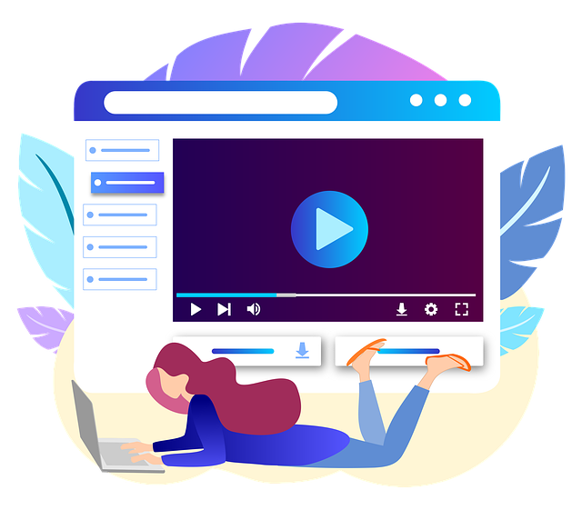
Accessibility as a set of design principles 2/2
General requirement to comply with the 2.1 WCAG guidelines (A & AA levels)
Key features of information and examples of user interface components
Perceivable – information must be presented in a way that is perceivable to the users
Text alternatives (alt text for images)
Captions for prerecorded media
Color contrast (4.5:1 minimum)
Operable – interface must be usable via different input methods
Keyboard access
No keyboard traps (navigation in and out of elements)
Consistent navigation
Understandable – content and operation must be clear and predictable
Language of page
Predictable behavior
Error suggestions
Robust – content must work with assistive technologies
Compatibility with assistive technologies
Status messages are announced
Valid code parsing (correct interpretation)
https://www.saavutettavuusvaatimukset.fi/en/requirements-act-provision-digital-services/wcag-21-legal-requirements?toggle=2.1.1%20Keyboard%20A&toggle=1.2.6%20Sign%20Language%20%28Prerecorded%29%20AAA&toggle=1.2.4%20Captions%20%28Live%29%20AA
Copilot GPT-5 (11/2025) was used to assist in creating a summary of the WCAG 2.1 guidelines for the slide

Slide 12
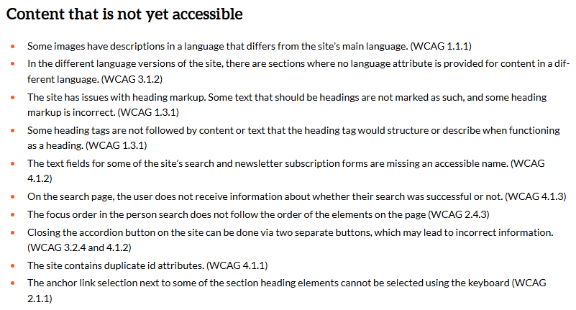
Example – Accessibility Statement of the JYU Website
← “analysis of
shortcomings”
→ It is not only important to 1) make content and systems accessible as possible, but also to
2) view accessibility as a process that is actively engaged with
https://www.jyu.fi/en/accessibility-specification

Slide 13
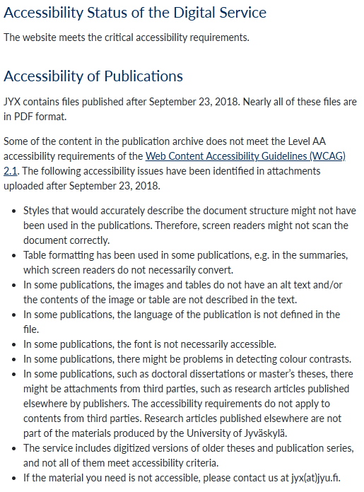
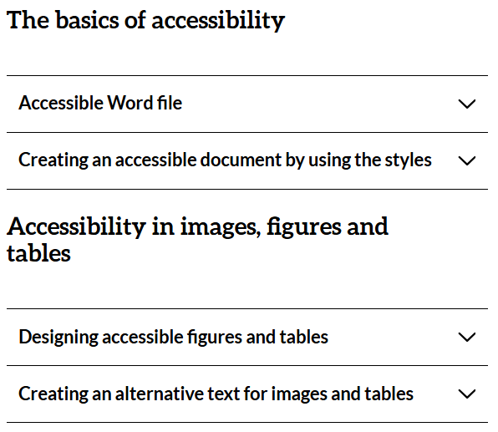
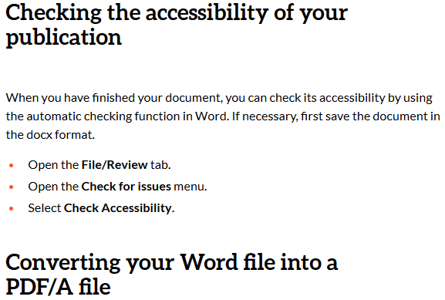
Example – Accessibility statement for JYX
Documents uploaded by students and staff → difficult to ensure that all content complies with the guidelines
https://jyx.jyu.fi/jyx/Content/saavutettavuus
https://www.jyu.fi/en/for-students/instructions-for-bachelors-and-masters-students/thesis-guide/accessibility-of-theses-and-online-publications

Slide 14

Digital Accessibility and Inclusive Education

Slide 15
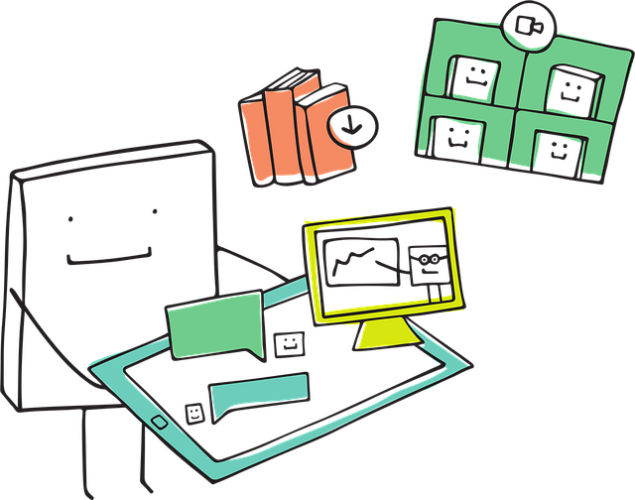
From Individual ICTs to a Network of Systems
Various digital environments are actively used by teachers and students at JYU, for example
Moodle (learning management system for providing course content for students, assigning and grading tasks etc.)
Sisu (student information system, where students enroll to courses and get their credits)
JYX (digital repository, incl. author versions of research articles, some research (meta) data and theses)
Converis (research information system, information about research projects, personnel, publications etc. and how these are linked)
Centralized help desk system (students and personnel can send in service requests as tickets on various topics related to their studies/work/use of ICT systems, that are forwarded to the right persons)
Core systems are managed on the university level by the JYU Digital Services unit (around 100 staff members)
JYU has around 1,700 academic staff; 1,000 administrative staff; 14,900 degree-seeking students (+ 26,000 adult education students at open university) → a little less than 50,000 potential users of systems and services
→ It can be a challenge for many HE institutions to provide consistent digital services to a
diverse user base
https://www.jyu.fi/en/about-us/introduction-and-key-figures

Slide 16
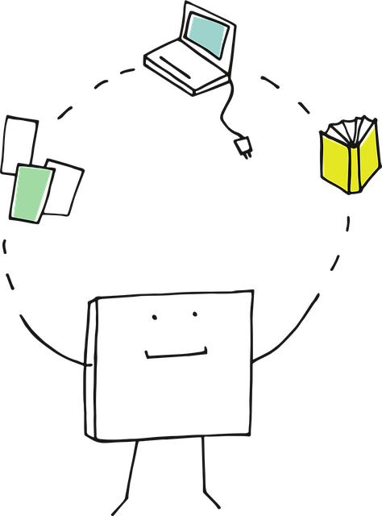
Design for All and the Need for Modification
Universal Design states that environments should be built to be usable by as many people as possible from the start (no need for special adaptations)
Although universal design can be a useful concept for understanding the accessibility of digital systems, universal design =/= one size fits all
Individual needs by definition vary and can translate to a very diverse set of system requirements
Software and hardware are not objects with fixed characteristics – changes in their design affect the system as a whole
Similarly, issues with (digital) accessibility can occur on different levels
e.g. student can have access to information through a screen reader, but co-occurring dyslexia can still make reading comprehension difficult
→ need for institutional practices that support identification
of individual needs (see previous presentation)
→ Systems should be built with their core functionalities and highest possible
level of accessibility in mind
→ Developers should not be afraid to modify the systems to increase the level
of accessibility once their accessibility-related knowledge increases
“A challenge when trying to formulate one single definition [of accessibility] is how to do this without falling prey to the metaphysical quest for essence and identity … Any single definition would have to be construed so that both the dynamics of the ever-changing contexts and the ever-changing capacities of the individual are taken into consideration.” (Persson et al., 2015, p.523)
Persson, H., Åhman, H., Yngling, A. A., & Gulliksen, J. (2015). Universal design, inclusive design, accessible design, design for all: different concepts—one goal? On the concept of accessibility—historical, methodological and philosophical aspects. Universal access in the information society, 14(4), 505-526.

Slide 17
Educational Practices and System Characteristics – Universal Design for Learning (UDL Framework)
The How
through system requirements
Principle 1: Engagement – Motivate and sustain learning
Provide clear, consistent structure in online courses (avoid clutter)
Offer choices in how students access materials (e.g., text vs. audio)
Reduce cognitive load by chunking content and using headings
Principle 2: Representation – Present information clearly
Add alt text for images and descriptions for charts
Provide captions and transcripts for all audio/video
Use plain language and explain technical terms or symbols
Offer summaries and key points for complex topics
Principle 3: Action & Expression – Enable diverse ways to respond
Allow multiple ways for students to submit work (text, audio, video)
Give clear instructions in accessible formats (structured documents)
Ensure activities don’t rely solely on drag-and-drop or mouse actions
Principle 1: Engagement
Customizable interface (themes, font size, color contrast)
Tools for reducing distractions (simplified view modes)
Principle 2: Representation
Built-in captioning and transcript support for media
Alt text fields for images and graphics
Adjustable text size, color contrast, and font options
Glossary tools and symbol explanations
Multilingual interface and translation support
Highlighting and annotation tools
Chunked content delivery and collapsible sections
Principle 3: Action & Expression
Full keyboard navigation and shortcuts
Voice input compatibility
Support for multimedia submissions (audio, video, text)
Accessible authoring tools for students and instructors
Goal-setting and progress tracking widgets (optional for accessibility)
??
- It can be difficult to talk about educational practice without going straight to system requirements (intertwined)
- However, important to view the “bigger picture” (doing due to policy vs. doing to fulfil the needs of individuals)
??
??
The “Why”
through educational practice
CAST (2011). Universal Design for Learning Guidelines version 2.0. Wakefield, MA: Author.
Copilot GPT-5 (11/2025) was used to summarize content for the slide from the perspective of digital accessibility

Slide 18

Accessibility of online materials as a driver of inclusive education
Digital accessibility in HE is a multifaceted phenomenon and can be viewed as an intersection where legislation, educational practice and system development meet
Because of this, it can be nearly impossible for one person to view the “whole picture” → need to highlight collaboration between experts of different fields
The goal of institutional activities should be on providing all students with a meaningful access to educational materials
Systems should be as accessible as possible to start with
Systems are never complete, but should nevertheless be worked on actively to increase the degree of accessibility
Small change from a system perspective can have a huge impact on the quality of life of a person → need for empathetic design

Slide 19

Aspects to think about regarding your institution’s policies / your own practices
What are my strengths as a person for making digital environments accessible to students?
Think about three things that make you an accessibility expert!
Which aspects of digital accessibility do my strengths relate to (e.g., legislation, educational practice, software development)?
How could I develop my competence in this area? Who are the people who can support me within my own institution?
What are the relevant institutional practices that can promote digital accessibility in my institution?
Are there official guidelines/policies?
Are the practices in line with the national (/EU) level requirements?
How does the IR used in my institution relate to the already established digital ecosystem and related services?
How can it be ensured that the system is compatible not only with data, but also with relevant practices and processes?
Flinga: https://flinga.fi/s/FKYXS5L
Flinga.fi
Access code: FKYXS5L
→ Add your strengths on 3 separate virtual post-its (you can match the color of each post-it to the different aspects) and any points of development you can think of

Slide 20
Additional points based on discussions
If you have any specific topics you would like to be included in these sessions, you can also add them as post-its to the Flinga board (https://flinga.fi/s/FKYXS5L)!
JYU’s main sites for accessibility-related information and documentation:
Instructions for students regarding accessibility https://www.jyu.fi/en/for-students/instructions-for-bachelors-and-masters-students/study-planning-and-counselling/accessibility-and-individual-services
Students apply for the individual arrangements at the Vasara system (same system is used for various institutional processes, e.g. submission of master’s theses)
“The most common individual arrangements are the following:
extra time for exams +20 min / exam hour
extended deadline for submitting assignments
extended loan period for course books
access credentials for Celia’s audiobook service
All discussions are confidential. The student decides how and to whom information related to the recommendation will be shared.”
Equality, non-discrimination and accessibility practices at JYU https://www.jyu.fi/en/about-us/organisation-and-management/regulations-and-principles/equality-and-diversity

Slide 21

Thank you! Questions?
saana.s.s.mehtala@jyu.fi
kati.clements@jyu.fi

